Slide 1

FILE SIZES & TYPES FOR WEB |
CONTENT: JUMP TO TUTORIALS
Notes:
This presentation will show you how to “optimize” images for the Web. It will teach you how to create files that are small enough to download quickly but still maintain professional quality.

Slide 2
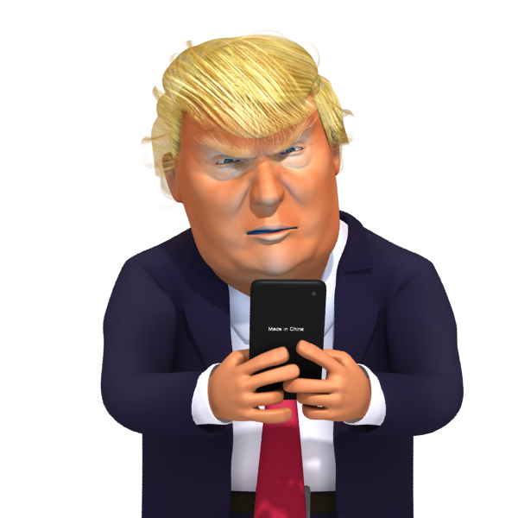

FILE SIZE
“It’s TOO
HYOOOGE”
The larger the file size is, the more vivid the image is,
but the harder to upload and download.
Designers are always mindful of size and
try to balance size against quality.

Slide 3
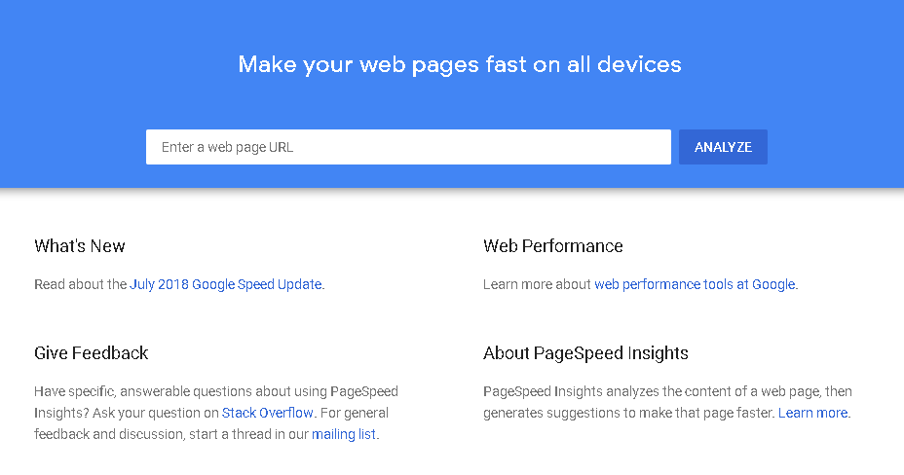
How fast will your web page download? Go to Google Page Speed Insights and enter the URL.

Slide 4
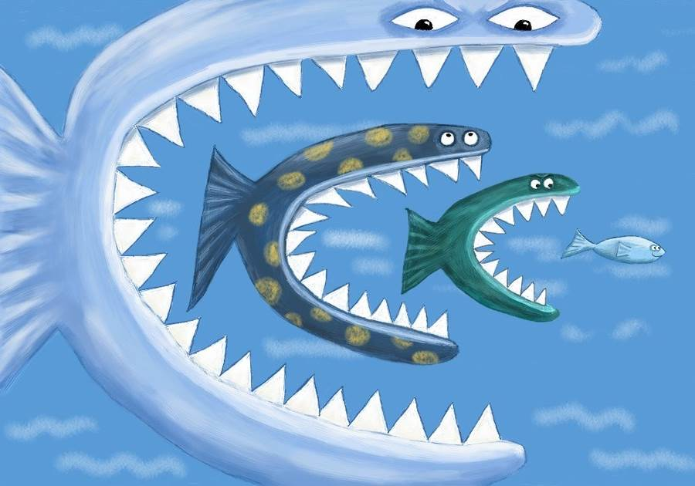
UNITS OF
MEASURE
1024 bytes = 1 Kilobyte (KB)
1024 kilobytes = 1 Megabyte (MB)
1024 megabytes = 1 Gigabyte (GB)
1024 gigabytes = 1 Terabyte (TB)
Notes:
The only way to get a feel for units of measure (of any kind) is to see examples (which are on the next slide), but here are the units of measure.

Slide 5
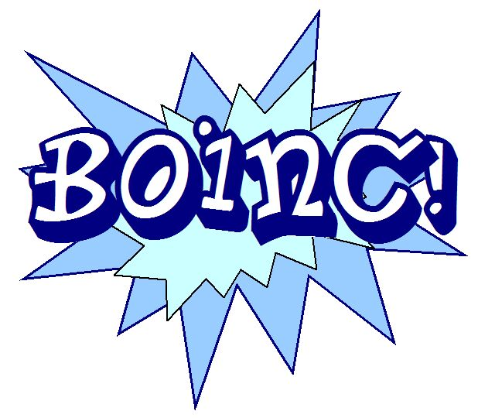
To Get An Idea (Examples)
Web Graphic Above (“Boing!) 7K (saved as a .gif)
Web Page Banner 2500px 200-300K (approx)
PPT or DOC with Images 2000K (approx. 2 MB) This PPT is 7MB
Photoshop file might be 20,000K (approx. 20 MB)
Short Video formatted for web 300 MB (but it’s streamed, not downloaded)
Short video formatted for theater 1 GB per minute (approximately)
Hard Drive Space 500-1000 GB (1 TB) typically
_____________________________________________
Note: These are just averages to show relative size—actual files vary greatly.
Notes:
Web files must be small to download quickly (an average web image might be 100K)
A typical banner running across the top of a web page, if it’s fully photographic, will be approximately 30-40K
The total size of all graphics on a web page usually should not exceed 100K.-200K for high-speed download.
PPT, DOC, and PDF files to be emailed or uploaded need to be fairly small as well, though people do expect to wait a for them to download . A reasonable size is about 2,000 K (2 MB)
Print files can get quite large—it’s not uncommon to have a flyer that’s 20,000 K (20 MB)
Photoshop authoring files can get huge, depending on a lot of factors, but sometimes you can have a file that’s as big as 200,000 K = 2,000 MB = 2 GB.
Video files are usually the largest. If you shoot a video in highest dimensions, for a movie theater, plan on 1 GB per minute. You can always save a version of that video for the Web.
Short videos formatted for social media might be a few hundred MB.
Hard drive space is measured in GB’s and TB’s (typically 500GB to 1TB)

Slide 6
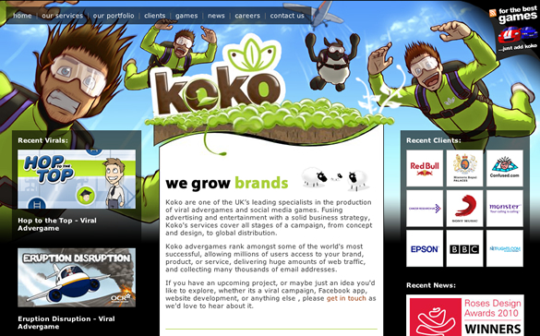
The Web Page Trade-off
The more graphics you have, the more impact you can have, but also the more download time is required.

Slide 7
What Impacts Size of an image?
Number of colors
Dimension
Resolution (how many pixels are in the graphic)
File Format selected

Slide 8
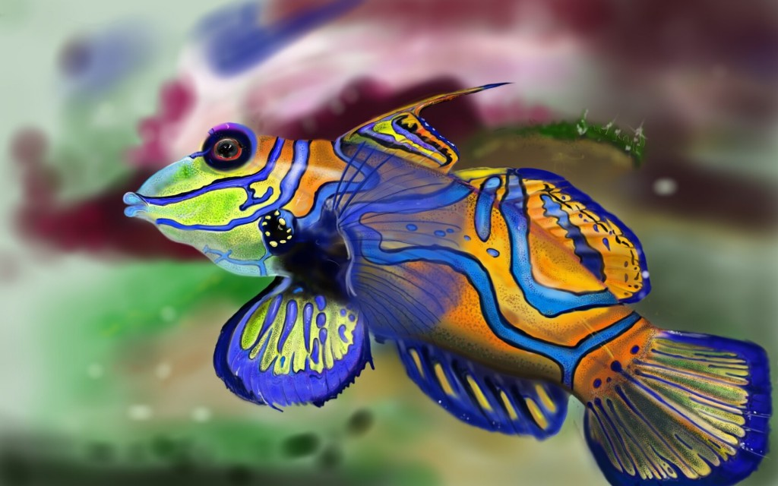
1. NUMBER OF COLORS
impacts size of a file
Notes:
First, the number of colors impacts the size of an image file.

Slide 9
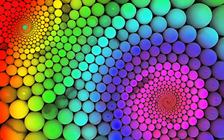
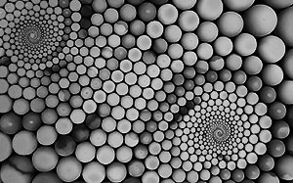
JPGs on “High”
Full color
37 Kilobytes
Black and White
27 Kilobytes
Notes:
The full-color image above is larger than the black-an-white image below. The file format is .jpg, which is used for images that are photographic or contain “continuous tone imagery” (such as gradients like the ones you see above).

Slide 10
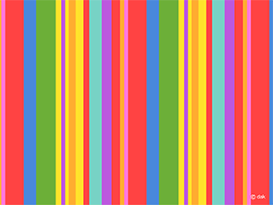
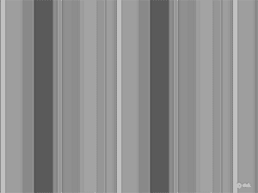
.gifs
32 colors
9 Kilobytes
16 colors
5 Kilobytes
Notes:
.Gif is the file format most efficiently used to optimize images with limited numbers of solid colors (e.g., cartoons; this striped pattern).
The color image on the top requires 32 colors to capture and is 9 kilobytes. The image on the bottom only needs 16 colors and is therefore much smaller.

Slide 11
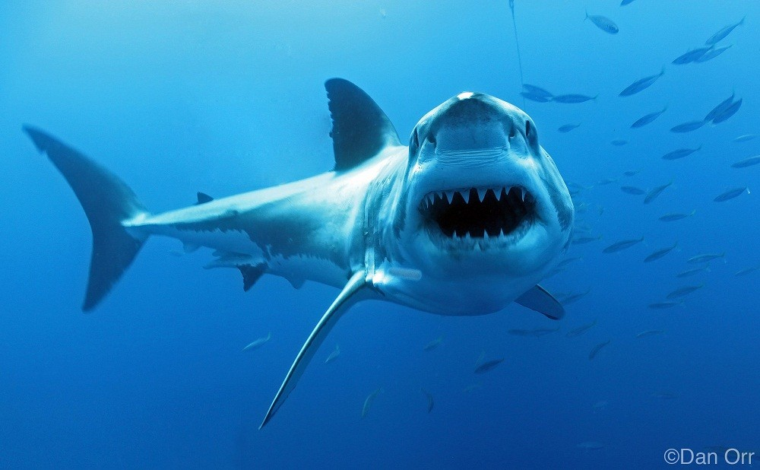
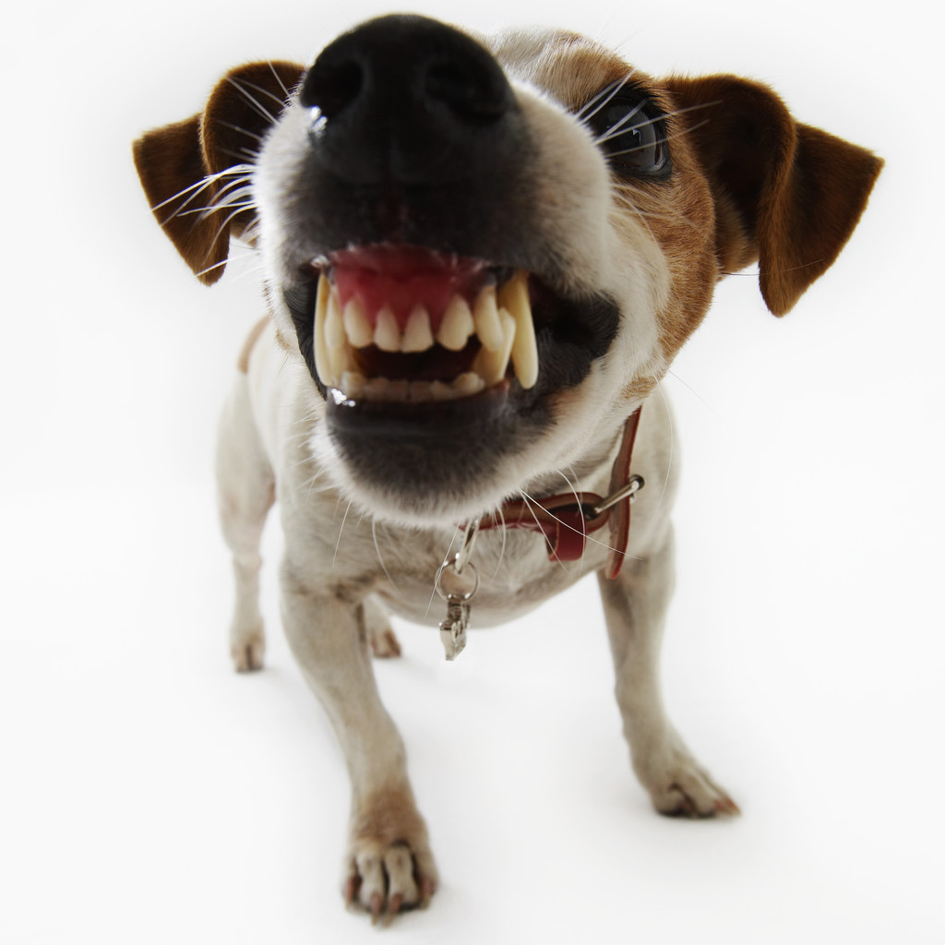
2. DIMENSIONS OF GRAPHICS
2. DIMENSIONS
impact size of a file
Notes:
Beyond number of colors, we see that the dimensions of an image impact file size. The larger the dimensions of a graphic, the larger the file size will be.

Slide 12
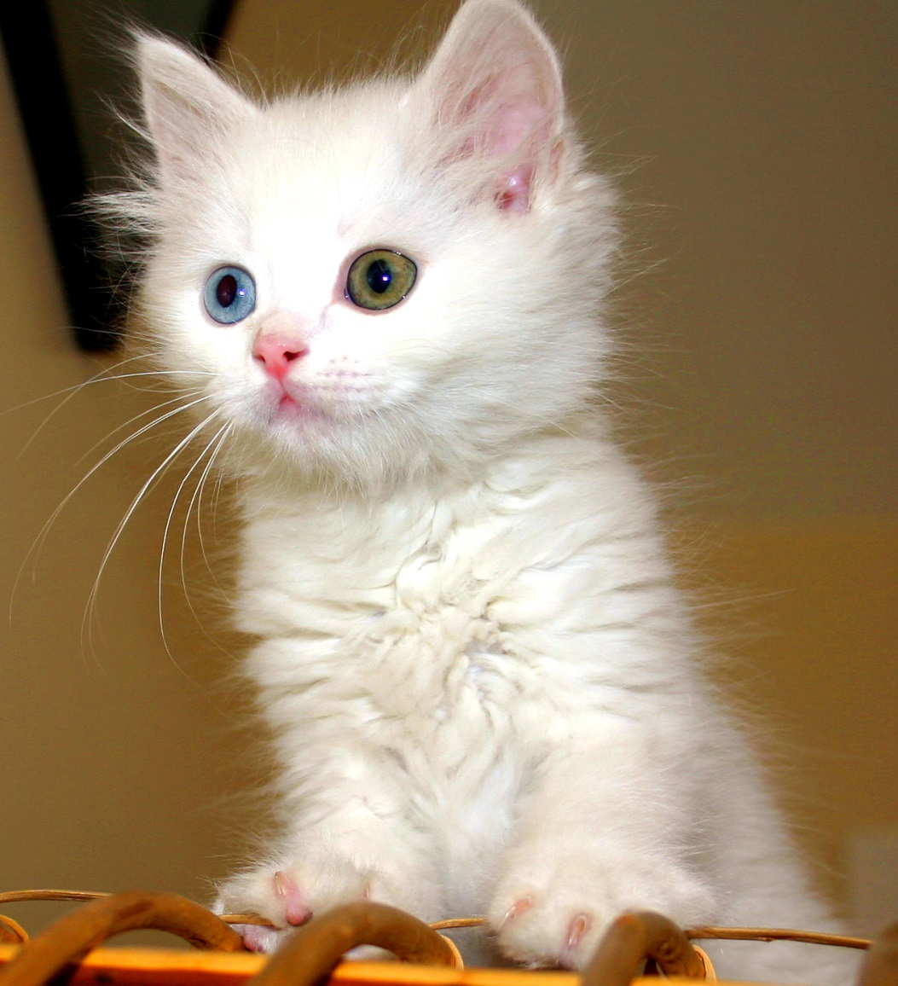

Resize Images to the needed size
BEFORE You Insert Them On the Web
Too often, people insert a large image on a web page that will actually appear quite smaller.
The file still contains the data of the large image, which can cause slow download times.
Therefore, it’s important to resize images before we insert them online instead of waiting until after we have inserted them.

Slide 13
Typical Image Sizes for Web
Web Banner: 2500px wide
Large image for web/social: 1000px
Small image for web: 400 px wide
Small profile photo: 100 x 100
Tiny profile photo: 50 x 50
See all social media image sizes here

Slide 14
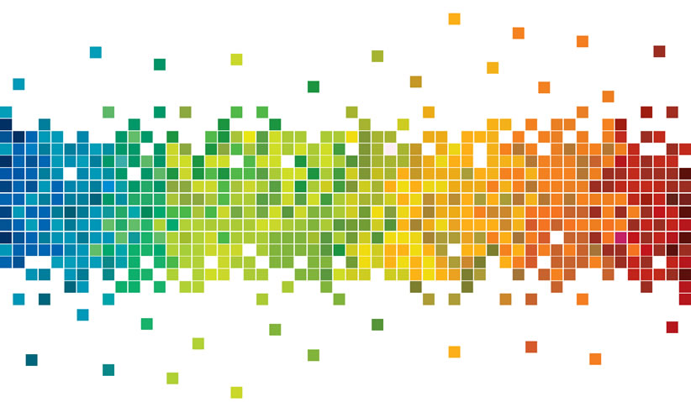
3. NUMBER OF PIXELS (“RESOLUTION”
impacts size of a file
Notes:
The size of a file is not only impacted by color and dimensions—it’s also impacted by what is called the “resolution.” What is “resolution?”

Slide 15
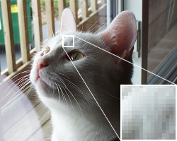
Pixels (also called “dots”)
Resolution is the number of pixels an image has, usually measured in “pixels per inch” (ppi), also referred to as “dots per inch” (dpi).
Pixels are the tiny squares that compose an electronic image.
An image with pixels is called a “bitmap” image or “raster-based” image.
Notes:
Resolution is the number of pixels an image has, usually measured in “pixels per inch” (ppi), also referred to as “dots per inch” (dpi).

Slide 16

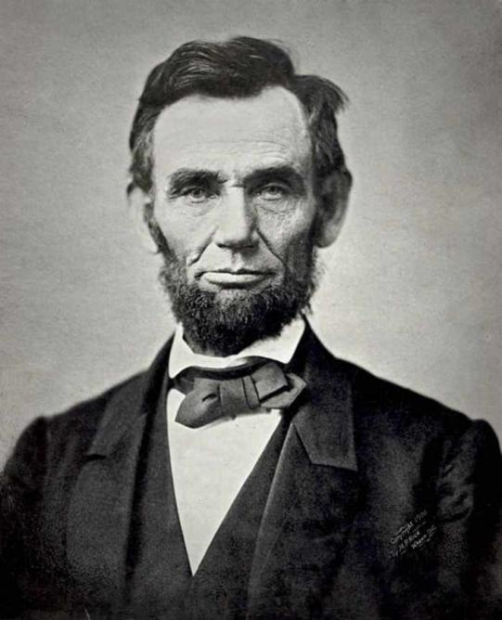
Resolution (higher and lower quality)
The more pixels per inch an image has, the higher the quality can be for print.
But you only need 72ppi for Web
Web: 72 dpi/ppi | High-Quality Print: 200-300 dpi/ppi | Low-quality Print 85-150 dpi/ppi
4 pixels per inch
72 pixels per inch
Notes:
On the right, we see Abraham Lincoln at 72 dots per inch, which is standard for the web (because the screen only allows us to read that many pixels per inch). On the left, we see 4 pixels for inch just to show how big the pixels get. If we want a quality high enough for print, we would need 200-300. Newspaper and magazines usually have lower quality (85-150 ppi).

Slide 17
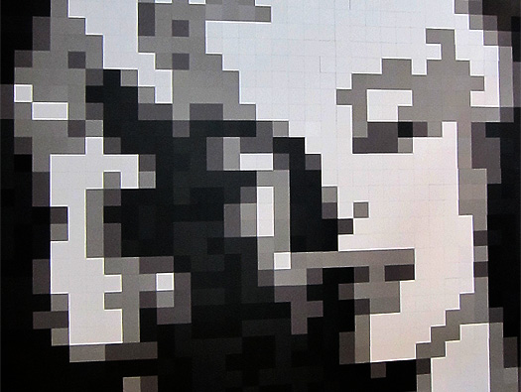
“Pixelation”
Refers to the condition of an image that has visible pixels.
Enlarging a bitmap image makes the pixels bigger, and they can become visible.

Slide 18
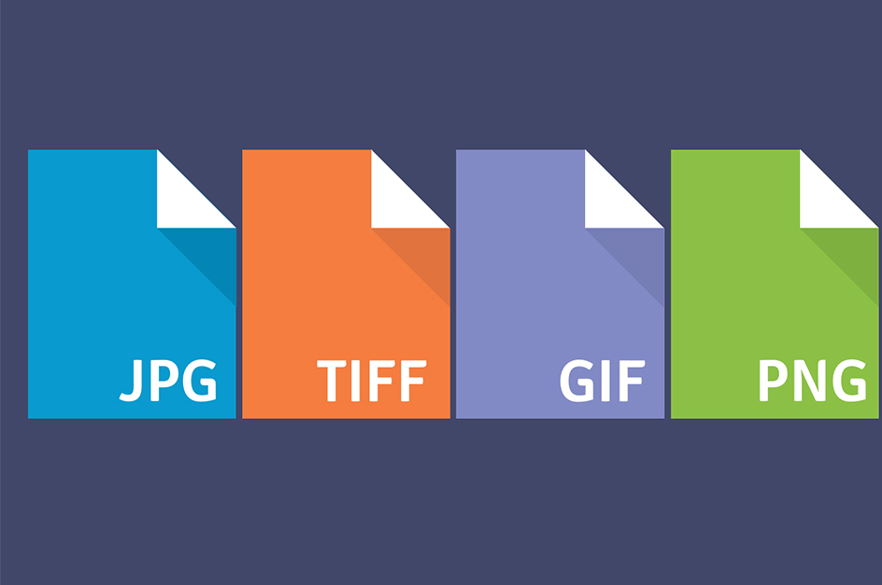
4. FILE FORMAT
impacts size of a file
Notes:
Now that you’ve checked or changed the resolution and dimensions of your image, it’s time to save your file in the proper format for online use. Knowing the right file format can mean the difference between an image that downloads quickly or takes way too long.

Slide 19

Professional photographers shoot in RAW format to start with the highest quality images (not .jpg, which is a compressed, low-quality file format)

Slide 20
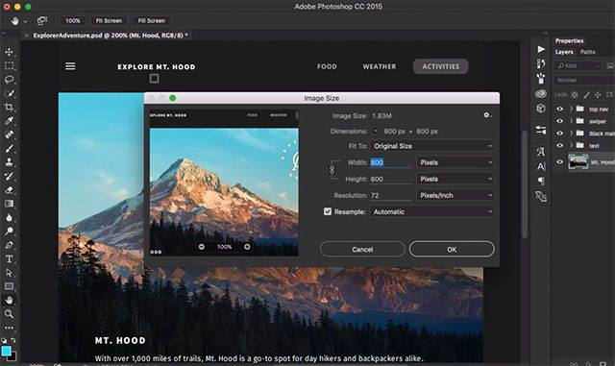
Then, you can take your images into Photoshop to edit them or use Illustrator or InDesign to lay them out. These authoring files (such as .psd, Photoshop document) are not used on the Web. Instead, you will save versions of these images for various uses, such as Web.
Notes:
First, authoring files are not used as online image files. You would not upload a .psd Photoshop Document to show an image on a web page.

Slide 21
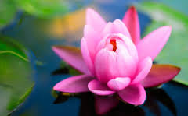

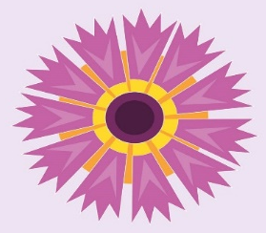

Save images for the web in the proper format.
4 Web Formats
JPG: For photos and other “continuous tone”
images, such as gradients. Supports thousands of colors.
.JPG format makes files small through compression,
so images are lower quality (they have a little blur).
JPG is easy to remember if “JP” reminds you of “just photos.”
PNG: For transparency around an image.
Any image can look great in .png,
but it’s significantly larger file size,
so only use it when you have to.
GIF: For images with solid-colored areas (cartoony).
Makes files small through limiting number of colors.
Only supports 257 colors (you select the number of colors used).
Images stay crisp because they are not compressed.
SVG: Saves vector, bitmap, and text images for web, unlike the other formats, which are all raster-based. Can be scripted. Can be exported from Illustrator (not Photoshop). Cannot be inserted in MS Word and other standard documents (yet).

Slide 22
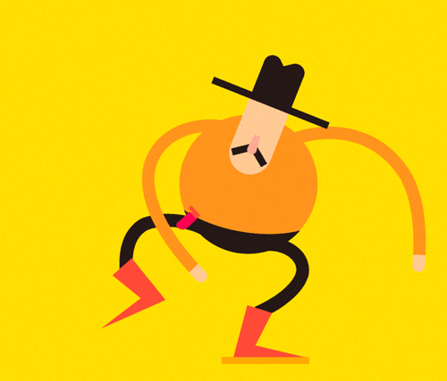
What’s an animated gif?
An animated gif
is a file with a number of images in it that are shown in a sequence to give the illusion of animation.
Animated gifs were intended to be used with images that had solid colors, but people started creating animated gifs with photos, as well, which result in unnecessarily large files and dithered images.
Video formats are usually more appropriate for animation of photographic images.
However, animated gif-makers have become popular for ease of use, and people have fun with them.
HOW TO MAKE AN ANIMATED GIF
IN PHOTOSHOP CC
Adobe Tutorial
Hubspot Tutorial

Slide 23
FILE FORMATS
Extension Format |  | Used for | `Loss | `# Colors | Transparency?
FORMAT | FORMAT | USED FOR | LOSS? | #COLORS | TRANSPARENCY?
.jpg | Joint Photographic Experts Group | WEB: Photos (and other continuous tone images such as gradients) | Lossy | Thousands | NO
.gif | Graphic Interchange Format (Compuserve) | WEB: Solid colors (e.g., cartoons) Web | Lossless | 256 + transparency | Yes, but BAD GIF-8 (jaggies)
.svg | Scalable Vector Graphic (open source Created by W3C) | WEB: Some vector Images, bitmaps, and text. images can be scripted | Lossless | 144 colors | Yes
.png | Portable Network Graphics format | WEB (any kind of images) | Lossless | Thousands | Yes (png-24) no jaggieds) but big file
.tif | Tagged Image File Format | PRINT ONLY | Lossless | Thousands | Yes
Notes:
Here’s a chart that provides this information and below is more info than you need.
Summary of Main File Formats:
Jpg, gif, and png are appropriate file for images on the Web, if the images are optimized at 72 dpi. If they are not optimized, they will be larger than necessary and cause slower download times. Both the nature of these file formats and the dpi make them low quality and therefore not usually appropriate for print (though many people do use large-format .jpgs for print because the file format is common and easy to share—just make sure it’s the best quality .jpg possible). On the other hand, .tif is used for print and is not appropriate for the Web (it’s way too large).
l  JPEG (.jpg) Joint Photographic Experts Group
Named after the group who created it, the jpeg is a file format useful for photographs and other continuous tone imagery (e.g., photographs). A jpeg can represent thousands of colors, so they can pick up the highlights in a person’s hair or the uneven tones of skin, etc. Unfortunately, jpegs are compressed files, meaning they are lossy (data has been reduced) in order to create small file sizes for the web. They are not appropriate for print unless they are saved on “Maximum” at higher dpi, and they will always be lower quality than a TIF.
l  GIF (.gif) Graphic Interchange Format
Created by Compuserve, a .gif is a file format used for very different kinds of images than jpegs are suited for. A GIF is only capable of 256 colors, so it is used for images with areas of solid colors, such as cartoons. There are three big upsides to a gif: 1) it is lossless, meaning it’s not compressed, so those solid colors usually look crisp, 2) file sizes can be very small if you opt to use a small number of colors—for example, a black and white image can be less than a kilobyte, 3) the GIF can have transparent background or exactly match the color of a web page background. Note that even though a gif is lossless, it is still being optimized at 72 dpi and is therefore not print quality. Animated gifs are made with a succession of gif files that are swapped out in swift succession by a JavaScript and therefore appear to be moving.
l  SVG (.svg) Scalable Vector Graphic
Created by W3C, .svg is a file format used for vector, bitmap, and text images. It’s capable of 144 colors, but can be scripted for animation and interactivity. It is a lossless file, so quality is not removed. It can support transparency. File sizes can get quite large.
l  PNG (.png) Portable Network Graphics Format
The Ping is an interesting file format. Like a jpeg, it supports thousands of colors. However, like a GIF, it supports transparency. Even better than a GIF, it can eliminate the little white jaggy edges around graphics with transparencies. The downside is that pngs are a little bigger in size than jpegs and gifs.
Print Formats
l  TIF (.tif) Tagged Image File Format
The .tif file format is appropriate for print at 150 dpi or higher (200 dpi for minimal decent resolution). It is a large lossless file. TIF files are generally way too large for the Web.

Slide 24
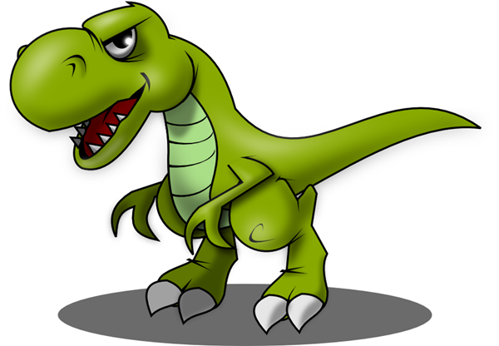
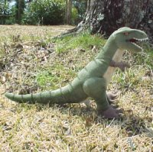
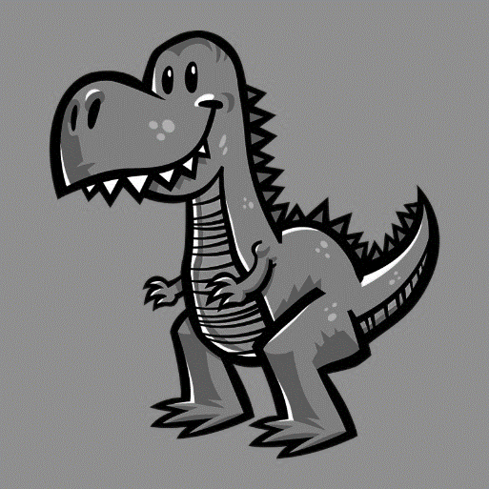
For Web, which image should be saved as GIF? And why?
Which should be saved as a JPG? And why?
Which should be saved as a PNG? And why?
A B C
Notes:
Answers:
A: Save as .jpg (because it’s a photo)
B: Save a a .gif (because it has solid colored areas)
C: Save as .png because it has transparency (it also has gradients, which would mean it should be saved as a .jpg if there were no transparency).

Slide 25
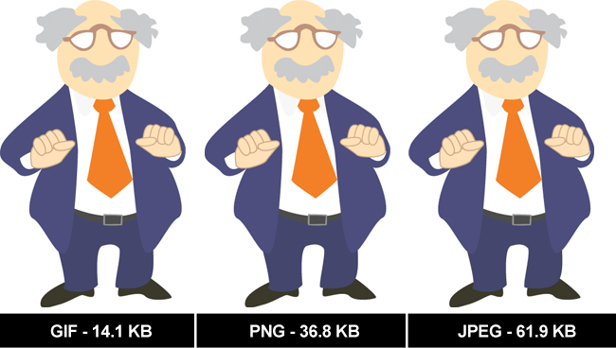
What file format should this be and why?
Notes:
Even when you can’t tell the difference in image quality between file formats, you can tell in file size.
Choosing an inappropriate file format will result in a significantly larger file size.
Answer: GIF at 14.1KB. GIFS were made for images with solid colors.

Slide 26

Remember:
Always start a Photoshop image at the highest dimensions and largest number of pixels per inch you will ever need (e.g., for print, 200 dpi and a full page size).
You can always create a version later for web at lower dpi or dimensions, which takes away quality.
But you can’t add quality back in after it’s taken away.
Even if you increase the pixels per inch later, the image won’t get better because the image has already been degraded.
Also, remember to always keep your Photoshop layers intact so you can edit later as needed (do not merge/flatten layers).

Slide 27
FAQ’s
What if someone hands me a .jpg to use in print?
ANSWER: If it’s high enough quality, you can get away with it. Some photographers even shoot in .jpg (even though they should use RAW). Check to see if the image looks professional when you test print. If not, find new image.
When should I use a .PDFs?
PDF’s are files that “freeze” the graphics on a page of a document so that fonts, graphics, etc., appear as intended.
PDF’s are used for documents that will be printed
or downloaded from the Web.

Slide 28
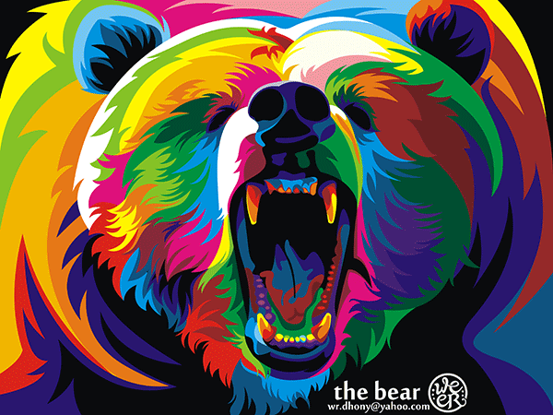
OPTIMIZING IMAGES FOR WEB

Slide 29
Optimization
To “optimize” a file means to make it the best for web use, balancing file size and image quality.
Changed dimensions to 400 x 300 px
(198K)
Original File 3423 x 2567 px
1MB (1,026K)
Saved version in the GIF file format
(28.53K)
Notes:
This image of the bear started at 3,423 px wide and was 1MB large (way too big for online use).
The steps we used to optimize it are those you learned earlier in this PowerPoint:
1) IMAGE>IMAGE SIZE. We made the image smaller in dimensions, 400 x 300 px.
2) We also made sure the resolution of the image was 72 ppi.
These steps brought the image size down to 198K.
3) FILE>EXPORT>SAVE FOR WEB. We saved the image as a GIF (because it has areas of solid colored images), which brought the size down to 28.53K.
SUMMARY: The difference between the original (1,026K) and the version saved for web (28.53K) is almost 1,000K. That’s a big file size difference.

Slide 30
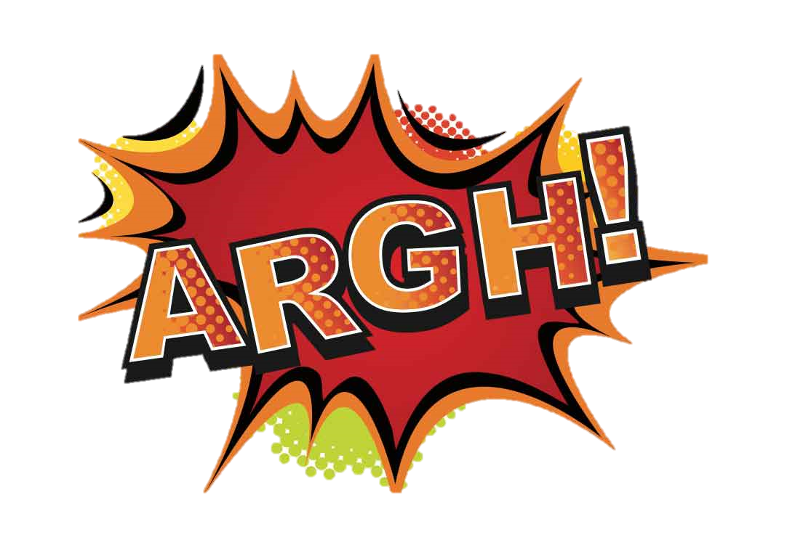
WHEN GOOD GRAPHICS GET SAVED BADLY . . .

Slide 31
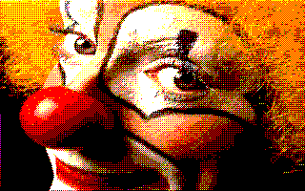
Dithering
In a dithered image, colors that are not available in the palette are approximated by a diffusion of colored pixels from within the available palette.
In other words, your software attempts to compensate and fill in the gaps when there’s too much compression or limited color scheme.
Sometimes, this looks really bad
This photo was saved
as a .gif rather than .jpg,
with not enough colors.

Slide 32
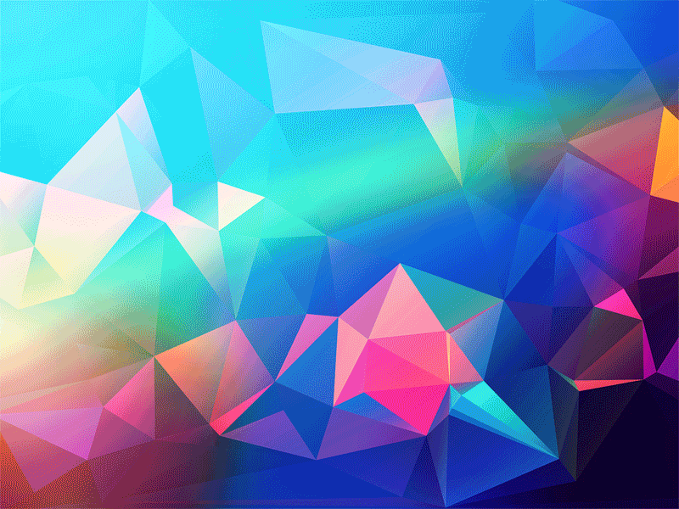
Why does this animated gif have little dots that show it’s dithering?
Is this image suitable for the gif format? Why or why not?
Notes:
A: The GIF format has a limited number of colors, so it is suitable for images with areas of solid colors. This image has gradients, which means it requires a lot more colors to depict the gradual change of colors. GIF does not have that many colors, so the image dithers as the dots attempt to cover as many colors as it can.

Slide 33
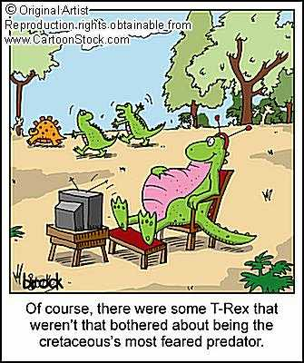
Another way dithering happens:
How should this cartoon have been saved: jpg or gif?
How was it saved instead?
Notes:
Dithering also happens when an image with large areas of solid colors is saved as a .jpg (it should have been saved as a .gif).

Slide 34
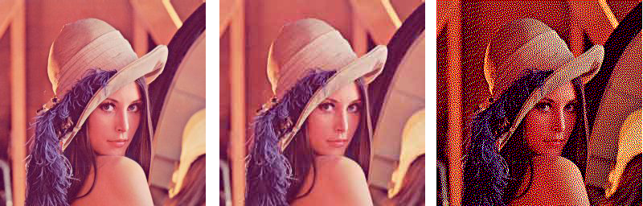
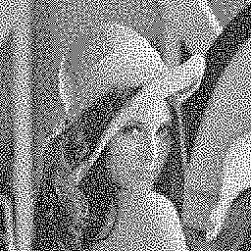
Poor quality .jpg .jpg saved again as .jpg gif 8 colors gif 4 colors
Dithering happens when:
- a .jpg was saved at a poor quality (too much compression)
- a .jpg was saved again and again as a .jpg (recompressing)
(instead, always start with the original)
- a photo was saved as a .gif (with few colors) rather than .jpg
- a solid-colored image (like the cartoon dinosaur) was saved as a
.jpg instead of a gif (edges get fuzzy).
Dithering is different from pixelation.
Dithering occurs when photos are not optimized properly.
Pixelation happens when photos are enlarged (pixels get larger).

Slide 35

Social Media Images
Q: “Why do my SM images look so much worse when they post?”
A: These platforms compress your images again (after they’re already compressed)
and make them smaller.

Slide 36
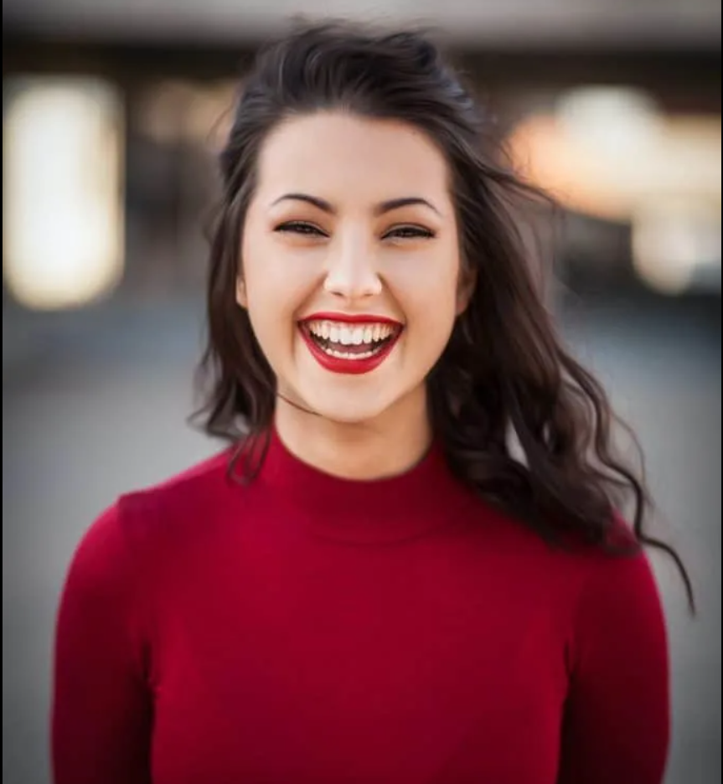

How to Export Images for SM
Sprout Social’s Always-Up-to-Date _x000b_Social Media Image Sizes
NOTE: You can double your pixels on Instagram
dimensions for higher quality.
Export as:
jpg
Quality: 76% to100%
sRGB checked

Slide 37

When to use a .png
A .png does everything a .jpg OR .gif can do PLUS it creates beautiful transparency (which we’ll see in a second). It’s also a higher quality image than a .jpg.
The drawback is that .png tends to be a dramatically larger file size than .gif or .jpg, so it wasn’t used much for a long time. However, as bandwidth increases, the .png is seen as a versatile, quality format and is used more widely. Just be careful of download times on large-dimension images.
Notes:
SOME TRIVIA: The PNG file format was created as a non-patented file format because GIF and JPG were patented, and the owners were going to start charging us all for their use. So, a bunch of computer dudes got together (and they were, indeed, all guys) to create a file format that would do everything .gif and .jpg can do—only better, and they gave it away (for free!), thereby undermining any future profit potential on the gif and jpg. Yay! Thanks to them, we don’t have to pay for using file formats.
The only drawback is that .png tends to be a little larger size than .gif or .jpg (see note on slide).

Slide 38
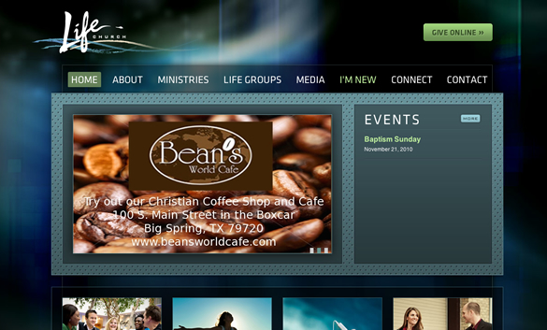
TRANSPARENCY
Notes:
If you look at this image, you will see many instances of transparency. The logo in the upper left corner has transparency all around it instead of a bounding box, so that the web page background shows through all around it.
The menu bar is black, but the opacity has been lowered so that the web page background shows through.

Slide 39
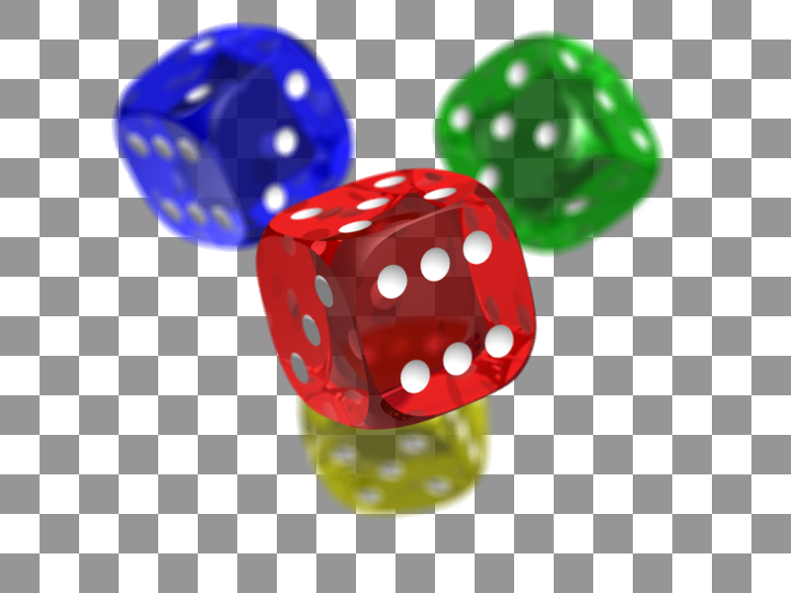
Transparency
In Photoshop, transparency is denoted with a checkerboard.
The background layer is turned off.

Slide 40
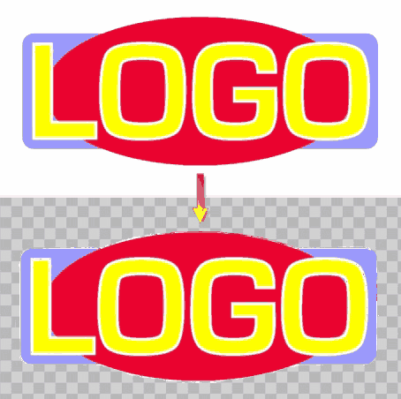
Transparency with odd shapes
Transparency around a graphic allows it to be placed on any color page.
This logo is surrounded by white, which is fine for a white page, but not a blue page. . . . It needs transparency.

Slide 41
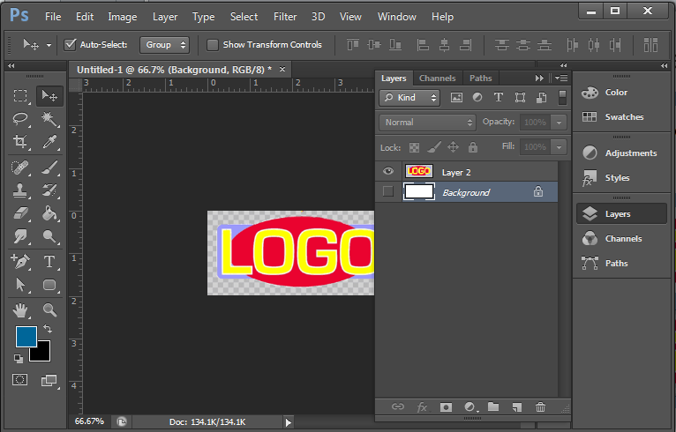
How to Save a .png with Transparency:
Open your file in Photoshop and turn off the background layer.
You will see a checkerboard in the transparent areas.

Slide 42
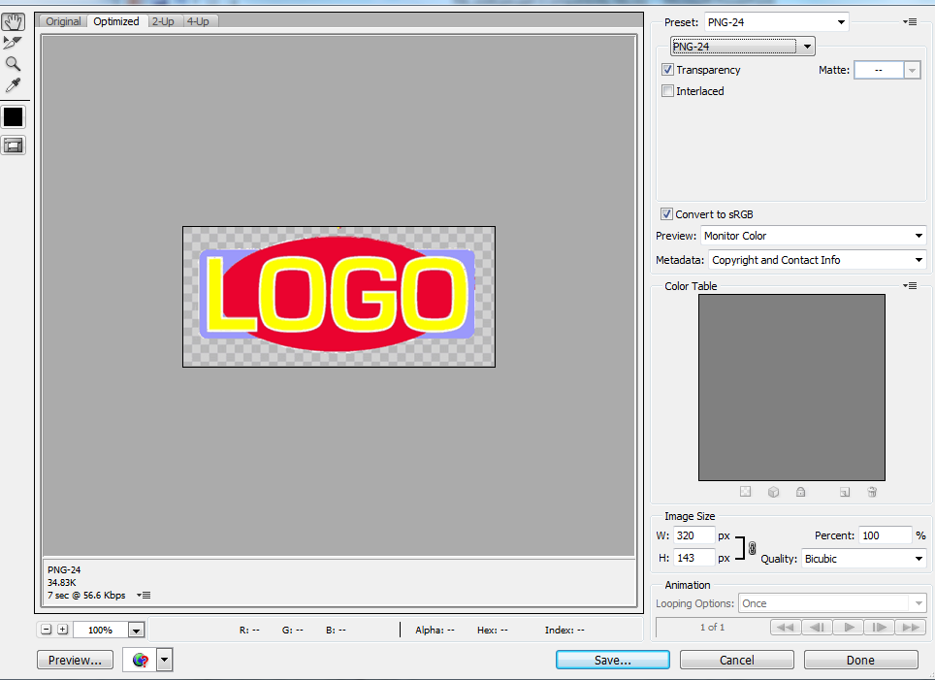
Save a .png with transparency:
Go to File > Export > Save for Web and select .png 24.
Click the “transparency” checkbox.

Slide 43

.gif: “The dreaded white jaggies”
Notes:
The .gif file format supports transparency, as well, but it also creates the “dreaded white jaggies” around the graphic. So we use .png instead.

Slide 44
White jaggies are undetectable on white background, but that defeats the purpose of transparency for use with any colored background. Solution: Use a 24-bit png

Slide 45
Avoid Confusion:
Transparency is often used in Photoshop compositions of all sorts, but you don’t have to use a .png unless you can SEE the checkerboard showing in your composition and the file is intended for web or e-viewing.
If you DO NOT SEE a checkerboard in your composition, it means you already have a background color or image you are using in the file. When you insert the graphic into a document or web page, the background of that page will not show through.

Slide 46
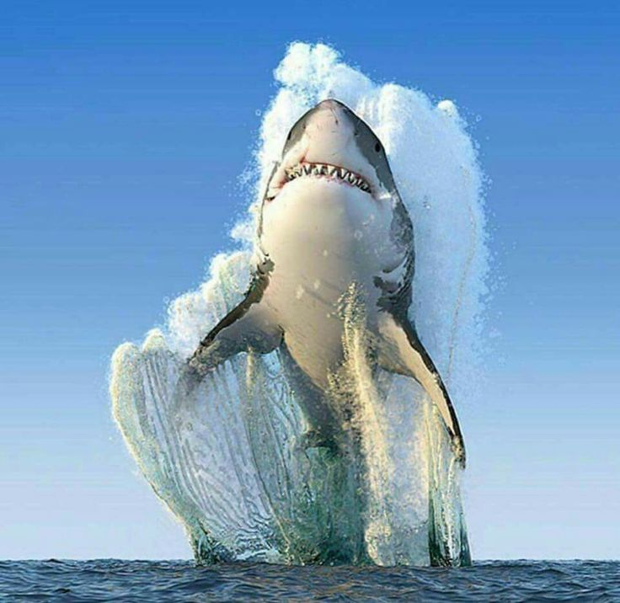
Quiz Yourself:
How would you save this? Andy why?
Photo for the Web
CHOICES
A. JPG
B. GIF
C. PNG
D. TIF
Notes:
Space down to find out the answer.
A. JPG. Remember, .jpg is the best file format for images of photos and other continuous tones (such as gradients).

Slide 47

Quiz Yourself:
How would you save this? And why?
CHOICES
A. JPG
B. GIF
C. PNG
D. TIF
Black and White logo on the web
with no transparency
Notes:
Space down to find out the answer.
B. GIF. Remember, .gif is the best file format for images with limited numbers of solid colors.

Slide 48

Quiz Yourself:
How would you save this?
CHOICES
A. JPG
B. GIF
C. PNG
D. TIF
Black and white logo with transparency
Notes:
Space down to find out the answer.
C. PNG. Remember, .png-24 is used for images with transparency.

Slide 49
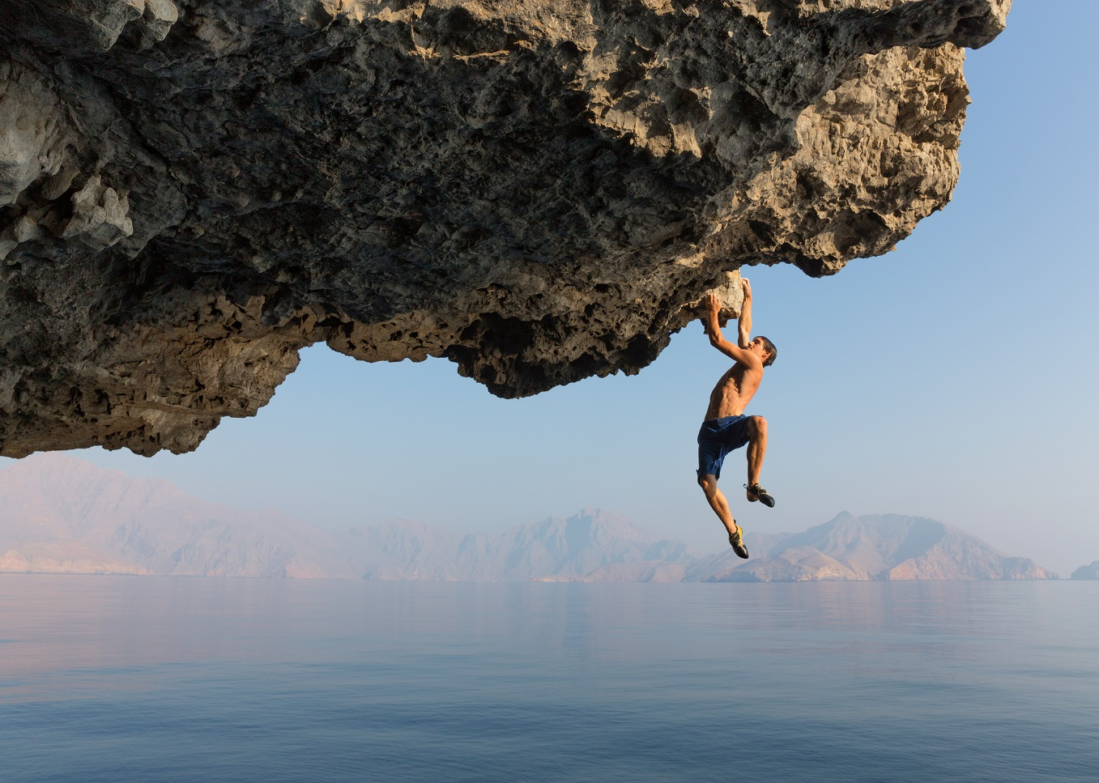
Quiz Yourself:
How would you save this?
CHOICES
A. JPG
B. GIF
C. PNG
D. TIF
Image for National Geographic print magazine
Notes:
Space down to find out the answer.
D. TIF would be the highest quality file format here and most appropriate for print. However, many photographers do shoot in the .jpg format.

Slide 50
TUTORIALS:
Resizing & Saving Images for Web
Walk-through

Slide 51
R E V I E W
To optimize files for the Web, you will change
Dimension: Change dimension of the image to be the exact dimensions you will need for the Web (not bigger or smaller).
Resolution: In Photoshop, change resolution to 72 dpi.
In Illustrator, there’s no “change” here because it’s vector-based.
File Format: Choose the proper file format for the highest quality and lowest download times.
- .jpg (on “high”) for photos
- .gif for solid colors (choose #of colors needed)
- .svg for vector images (Illustrator only)
- .png (at 24-bit) for transparency

Slide 52
Photoshop
Walk-through

Slide 53
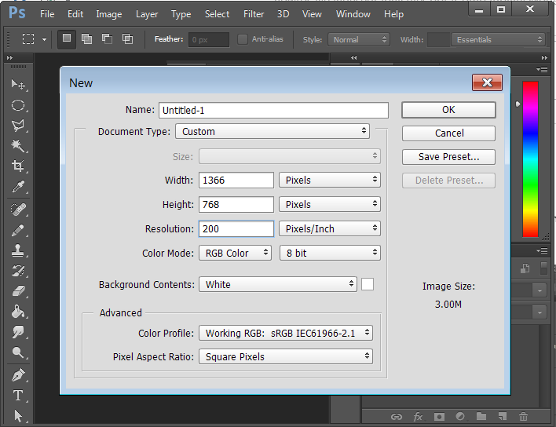
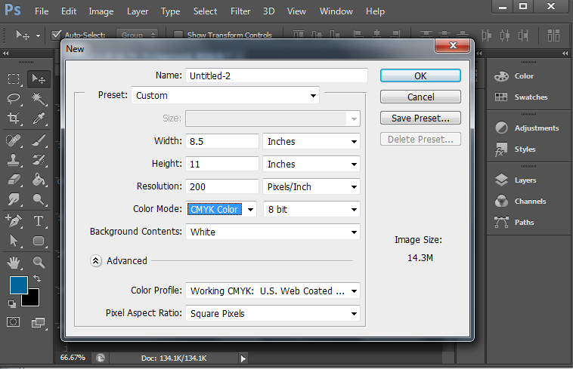
.PSD (FILE > NEW)
PRINT: 200 PPI/DPI CMYK | WEB: 72 PPI/DPI RGB
Notes:
To start a new Photoshop file at highest dimensions and resolution you will need, take these steps:
1) File > New
2) Set your width and height (in pixels or inches) for the largest size you will ever need. For example, let’s say the largest use will be a magazine cover at 8.5 x 11”. You can set those dimensions in “width” and “height.” In the example above, dimensions are set in pixels.
3) In the “Resolution” field, make sure you are working in “Pixels/Inch” and set it to the highest you will ever need (e.g., 200 or 300 ppi for print; 72 ppi for web). To play it safe, if you think you will ever need to use the file for print, start at 200 or 300 dpi. You can always save versions later at lower ppi.
4) In the “Color Mode” field, you can set RGB for web or CMYK for print. NOTE: Some people like to start in RGB for all files, because the colors are more vibrant—and then they shift to CMYK to create versions for print (duller colors) and keep the RGB files for use with Web.
5) Always save (and back up) the original file in this largest size.

Slide 54
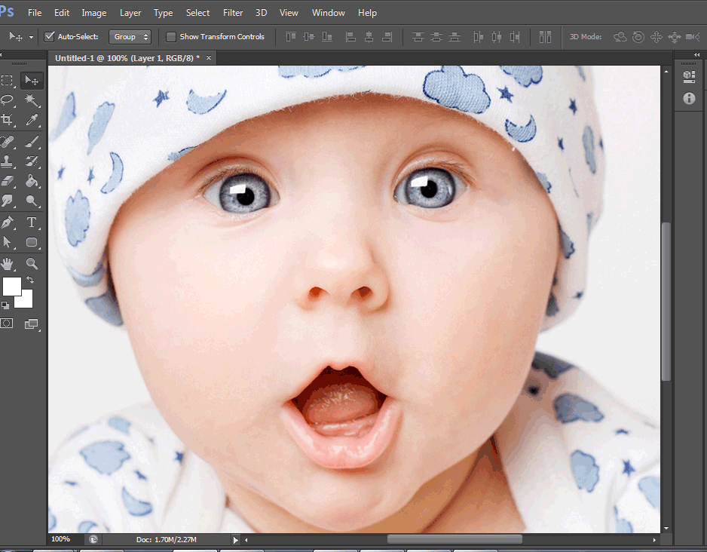
2) VIEW CURRENT IMAGE DIMENSIONS
& DECIDE ON NEW SIZE
- Set view at 100% to view your image in its actual dimensions.
(See the lower left corner field, type “100” into that field, press “Enter”)
- To decide the new size your image will appear on the screen, type in other percentages to see how it looks (e.g., 50%, 30%, etc.).
NOTE: Changing this only changes the view—not the image itself.

Slide 55
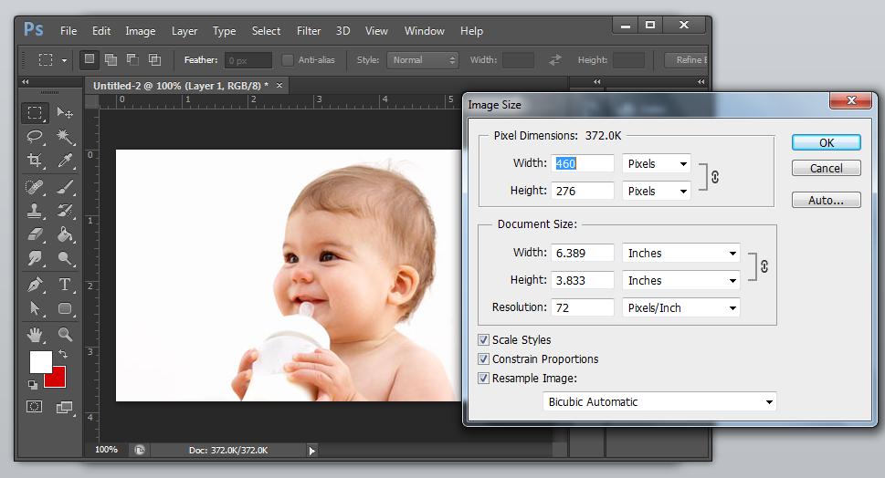
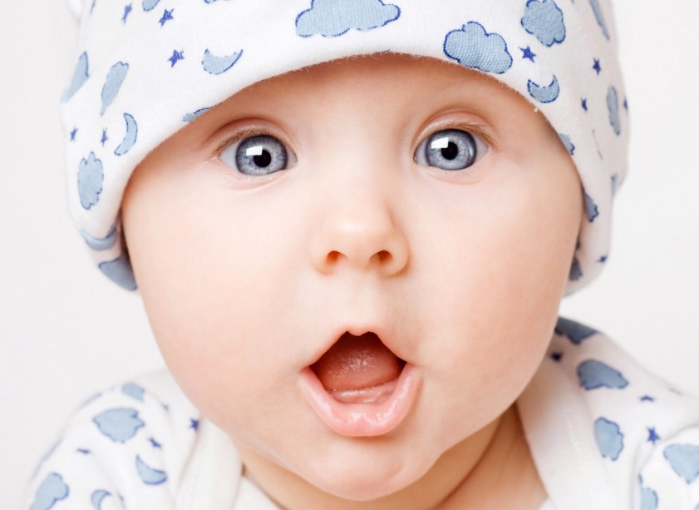
3) CHANGE DIMENSION TO NEW SIZE
1) Go to Image > Image Size
2) Make sure Resolution is 72 Pixels/Inch (if not, enter it)
3) Change Dimensions (based on your previous sizing—e.g., 50%). See notes on this slisde.
Notes:
EXAMPLE: If you want your new image size to be 50% of your original, look at the current “width” and see the number of pixels or inches wide it is. Type in the number that is half of that. The “Height” will change automatically to dimensions if the link icon is appearing between width and height (if not, you can turn it on).

Slide 56
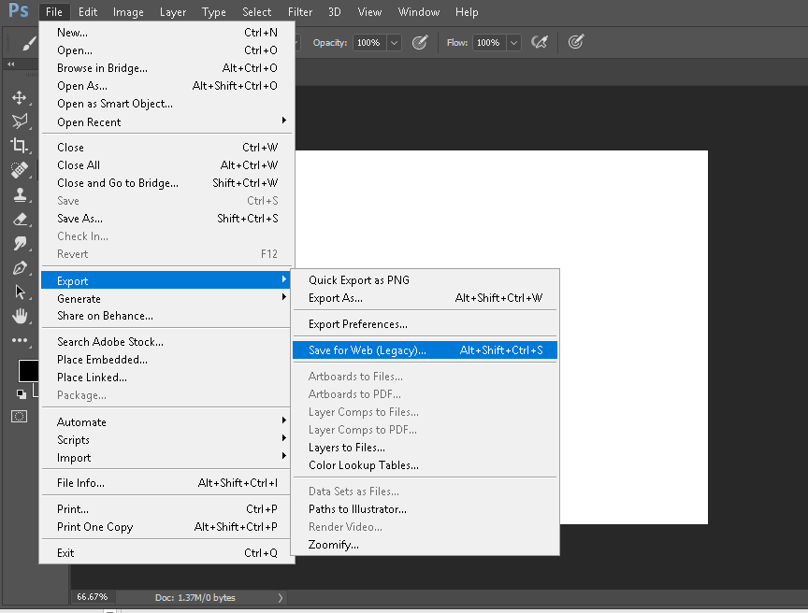
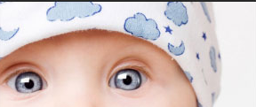
1) Go to File > Export>Save for Web
Notes:
To save a 2-dimensional image for the web, follow these instructions.

Slide 57
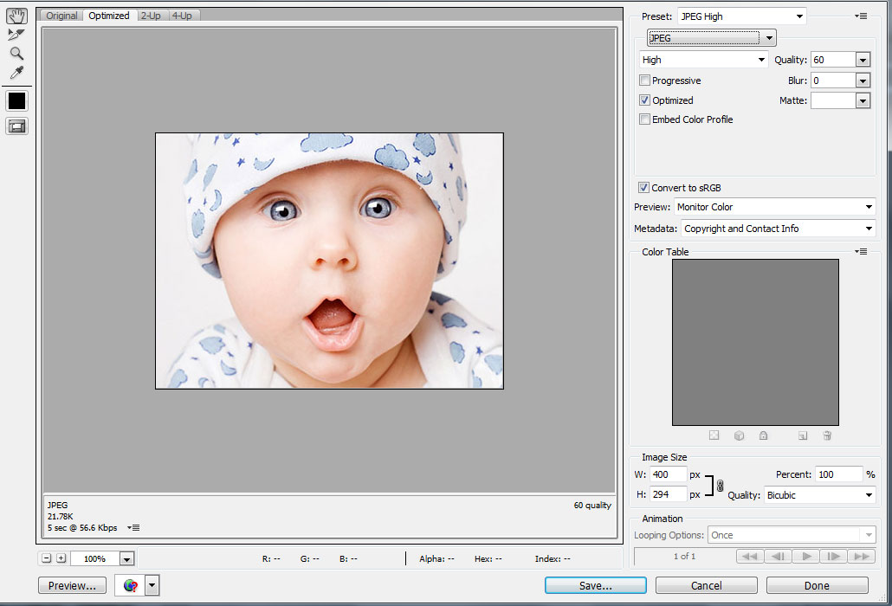
2) Choose .jpg (on high) for photos/gradients
Click “Save.”

Slide 58
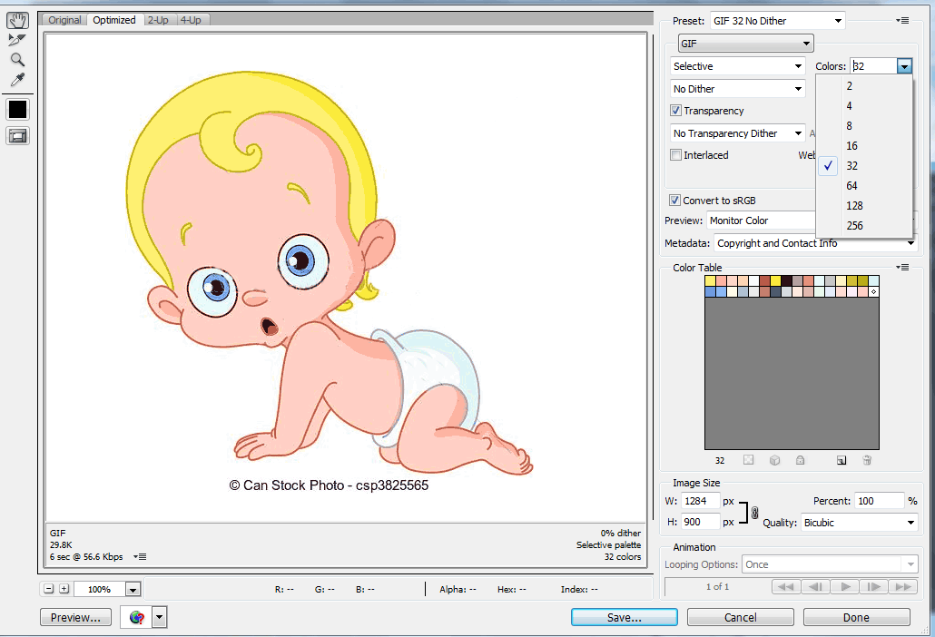
OR choose .gif for solid colors
Choose number of colors that create the best quality. Click “Save.”

Slide 59

OR CHOOSE .PNG 24 IF THERE’S TRANSPARENCY
Then, check “transparency.” Click “Save.”

Slide 60

Remember: to prepare your image for transparency first, you have to turn the background layer off in Photoshop.

Slide 61

TO COMPARE QUALITY:
1) FILE>EXPORT>
SAVE FOR WEB
2) CLICK “4-UP”
FILE>EXPORT>SAVE FOR WEB
You will be able to see different versions to choose from, judging quality. Here is the original at 198K
Examine your other choices.
WHICH IS THE
BEST CHOICE?
Notes:
Here’s how to view your options for saving a file for web in Photoshop:
1) FILE>EXPORT>SAVE FOR WEB
2) Click on “4-UP” to see four different versions Photoshop recommends.
3) Select the one that’s best (in this case, it’s the GIF) or create your own settings.
4) Click “Save.”

Slide 62
Illustrator
Walk-through

Slide 63

.AI (FILE > NEW)
PRINT: CMYK | WEB: RGB
The file can start in CMYK or RGB
(many recommend RGB for its vibrancy).
Illustrator will automatically change
the color mode for saving web files.
Notes:
- File > New
- Input the dimensions.
- Set the Color Mode (RGB for web; CMYK for print). NOTE: Some people like to start in RGB for all files, because the colors are more vibrant—and then they shift to CMYK to create versions for print (duller colors) and keep the RGB files for use with Web.
- Last but not least, create your illustration and save it as an .ai file (Adobe Illustrator) with layers intact.
Note: Illustrator is not a pixel-based program, so you will not set a dpi/ppi, but you can set “raster effects” (which most artists keep on high all the time, because they will adjust for web).

Slide 64

1) VIEW IMAGE AT 100%
Set view at 100% (lower left corner) and decide what new size
you want it to appear on the screen.

Slide 65

2) CHANGE IMAGE DIMENSIONS:
Select All (Ctrl+A or Command-A)
Hold down Shift key and drag a corner of the image.

Slide 66

3) CHANGE ARTBOARD SIZE TO FIT.
Select Artboard tool.
Drag an artboard corner to resize.

Slide 67

4) Go to File > Export>Save for Web
(“Legacy Save For Web” OR “Save for Screens”)

Slide 68

5) CHOOSE .SVG OR .GIF FOR SOLID-COLORED IMAGES
(which are typically created in illustrator) and choose #of colors.

Slide 69

OR choose .png 24 if there’s transparency.
Then, check “transparency.” Click “Save.”

Slide 70
QUESTIONS?

